Slide 1
Day 11
Issues with Cartesian-Space Paths

Slide 2
Joint Velocity Issues
consider the RR robot shown below
assume that the second joint can rotate by ±180 degrees

Slide 3
Joint Velocity Issues
what happens when it is commanded to follow the straight line path shown in red?

Slide 4
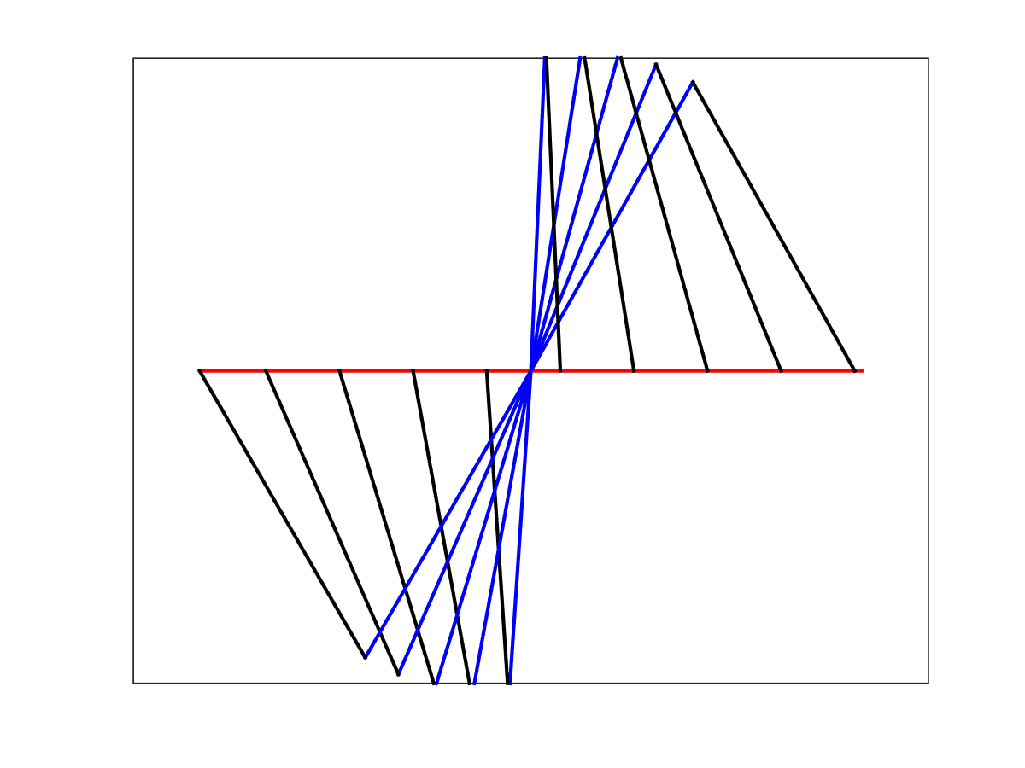
Joint Velocity Issues

Slide 5
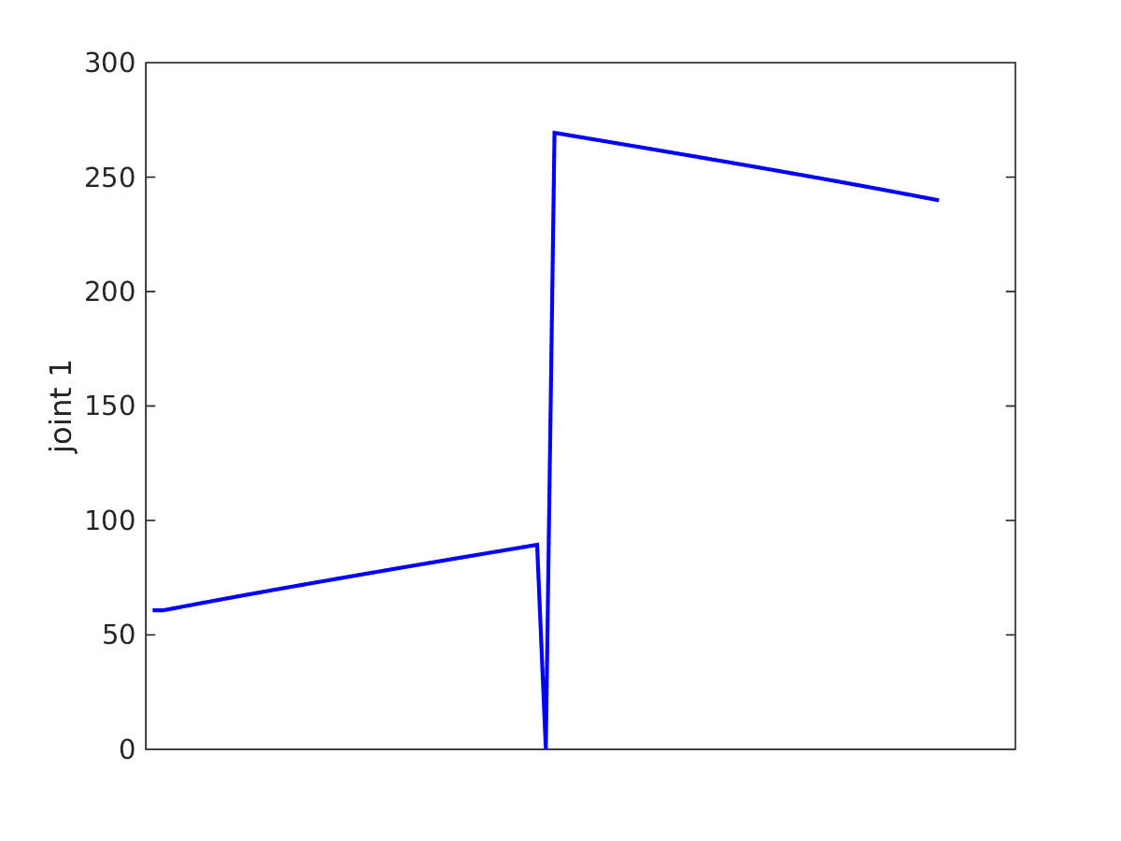
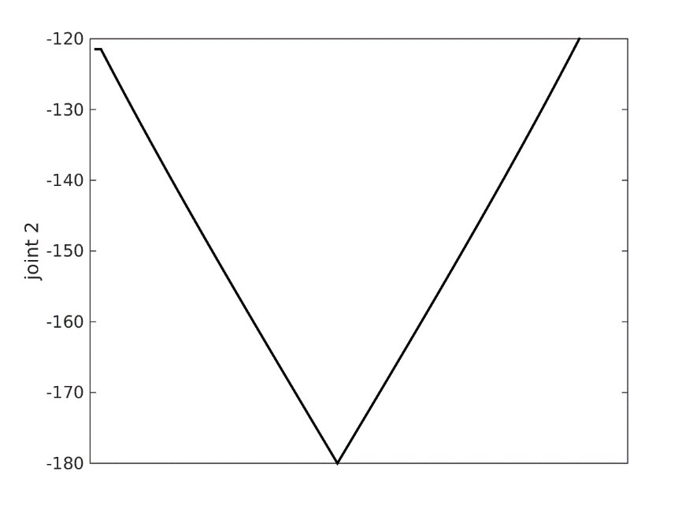
Joint Velocity Issues
jump discontinuity in first derivative = infinite rotational acceleration
steep slope = high rotational velocity

Slide 6
Workspace
the reachable workspace of a robot is the volume swept by the end effector for all possible combinations of joint variables
i.e., it is the set of all points that the end effector can be moved to

Slide 7
Workspace
consider the RR robot shown below
assume both joints can rotate by 360 degrees

Slide 8
Workspace
rotating the second joint through 360 degrees sweeps out the set of points on the dashed circle

Slide 9
Workspace
rotating the first and second joints through 360 degrees sweeps out the set of all points inside the outer dashed circle

Slide 10
Workspace
workspace consists of all of the points inside the gray circle

Slide 11
Workspace
workspace consists of all of the points inside the gray circle

Slide 12
Workspace
consider the RR robot shown below where the second link is shorter than the first
assume both joints can rotate by 360 degrees

Slide 13
Workspace
rotating the second joint through 360 degrees sweeps out the set of points on the dashed circle

Slide 14
Workspace
workspace consists of all of the points inside the gray area

Slide 15
Workspace
consider the following straight line path shown in red
start point, end point, and all points in between are reachable

Slide 16
Workspace
consider the following straight line path shown in red
start point and end point are reachable, but some points in between are not reachable

